Slide 1
Network Models and Protocol Suites
CCE 211 Data Communications and Engineering
Prof. Dr. Md. Samsuzzaman
Based on lecture materials from Data Communications and Networking, 5th ed., Behrouz A. Forouzan, McGraw Hill, 2012.
Revised 2019-07-28

Slide 2
Outline
Communication abstraction
Layered tasks
Internet protocol suites
ISO's OSI model

Slide 3
Layered Tasks
Computer networks are complex systems
Tasks involve varieties of hardware and software components, and protocols
Networking task is divided into several subtasks, or layers

Slide 4
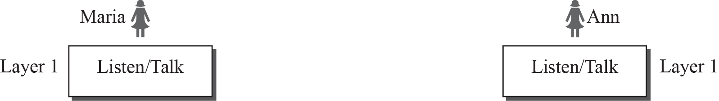
Figure 2.1: A single-layer protocol

Slide 5
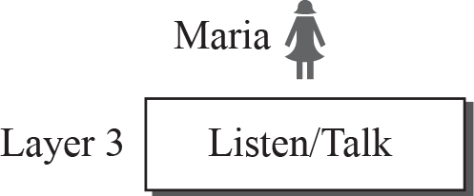
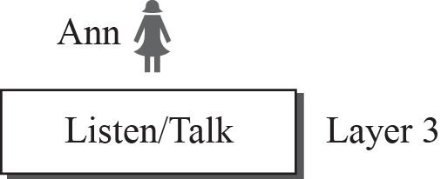


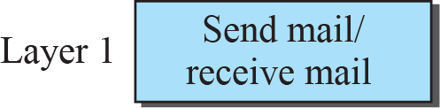
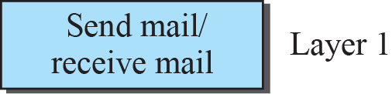
Figure 2.2: A three-layer protocol

Slide 6
2.1.2 Principles of Protocol Layering
Let us discuss two principles of protocol layering.
The first principle dictates that if we want bidirectional communication, we need to make each layer so that it is able to perform two opposite tasks, one in each direction.
The second principle that we need to follow in protocol layering is that the two objects under each layer at both sites should be identical.

Slide 7
2.1.3 Logical Connections
After following the above two principles, we can think about logical connection between each layer as shown in Figure 2.3. This means that we have layer-to-layer communication. Maria and Ann can think that there is a logical (imaginary) connection at each layer through which they can send the object created from that layer. We will see that the concept of logical connection will help us better understand the task of layering we encounter in data communication and networking.

Slide 8
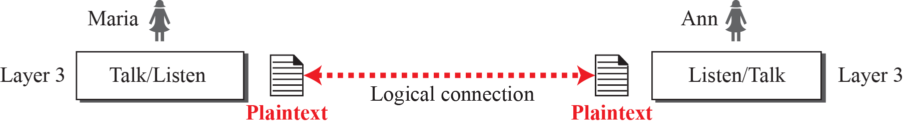
Figure 2.3: Logical connection between peer layers

Slide 9
Real-Life Example
Communication takes place thru many entities
Logical communication
Secretary: reads and reports the message
Secretary: types a letter
Delivery boy: drops the letter
Delivery boy: takes the letter
Postal truck
Post office:
Processes and routes the letter

Slide 10
Layer Model
Layer N uses services provided by Layer N-1
HOST A
HOST B
Logical communication path
Layer N
Layer N
Layer N protocol
Using services
Providing services
Layer N-1
Layer N-1
Layer N-2
Layer N-2
Virtual Communication System

Slide 11
Why Layers?
Guidelines for protocol developments
Reference model
Modularity
Eases maintenance and updating of systems
A change in one layer is transparent to the rest
Is layering always the best thing to do?
Maybe not ⇨ cross-layer optimization

Slide 12
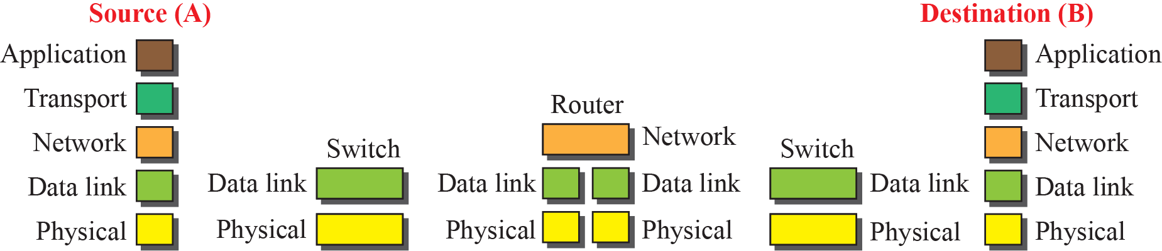
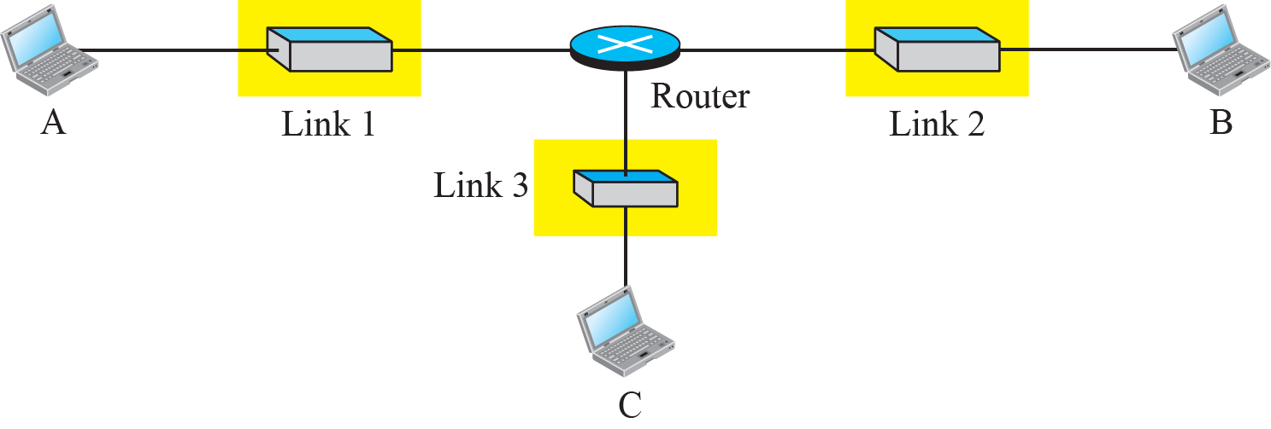
Figure 2.5: Communication through an internet

Slide 13
Communication Abstraction
Application-to-application communication
A
B
application process
application process

Slide 14

Communication Abstraction
End-to-end data transport over the Internet
Internet
A
B
Transport service

Slide 15

Communication Abstraction
Data routing service over the Internet
Internet
router

Slide 16

Communication Abstraction
Node-to-node delivery
link
link
link

Slide 17
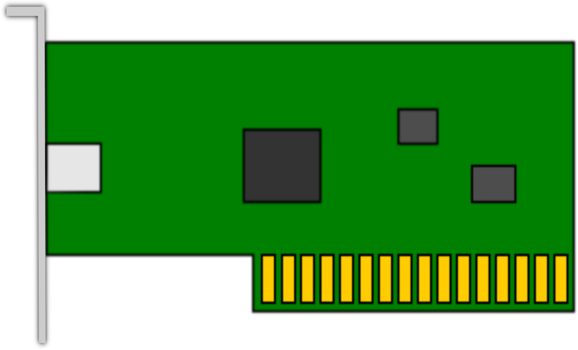
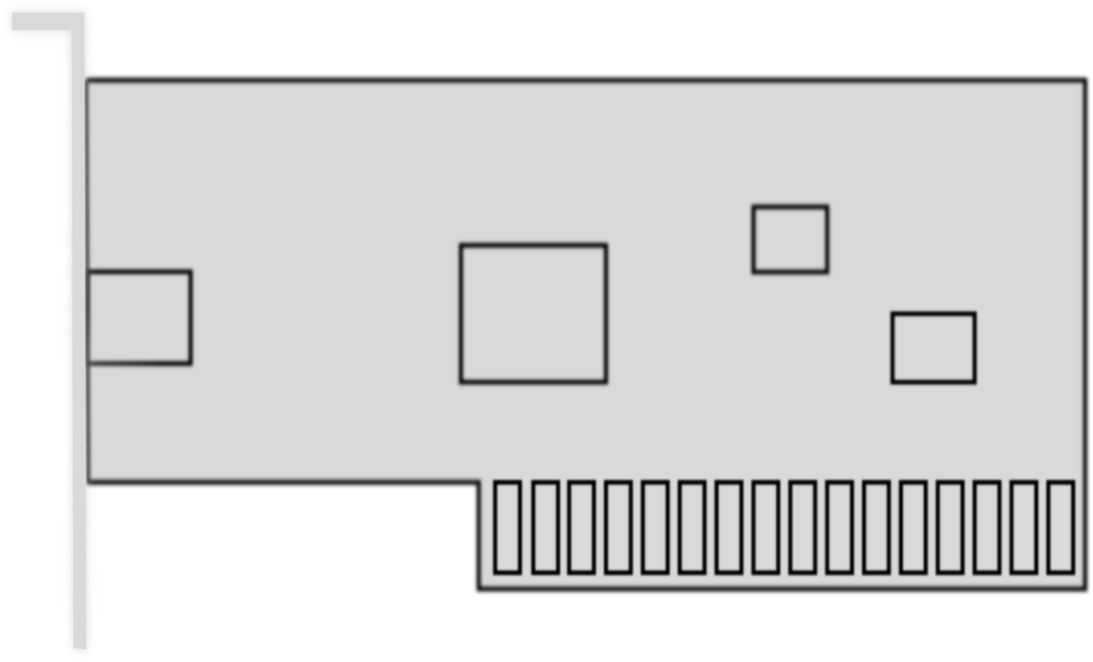
Communication Abstraction
Signal transmitted over physical media
Point-to-point link (optical fiber, copper, etc)
NIC (Network Interface Card)
Multipoint
Wireless
Image by OpenClipArt-Vectors from Pixabay

Slide 18
Internet Layer Model/TCP IP layer
The Internet Protocol Stack
User
Application Layer
Transport Layer
Network Layer
Data Link Layer
Physical Layer
Software
Hardware
Transmission Medium

Slide 19


Application Layer
Responsible for providing services to the user application
The only layer to interact with users
(source)
(destination)
Data
Logical communication
Data
Application Layer
SMTP
HTTP
FTP
SMTP
HTTP
FTP
Data
H5
Data
H5
Transport Layer

Slide 20
Transport Layer
Responsible for delivery of a message from one process to another
Duties/services
Port addressing
Segmentation and reassembly
Connection control
Flow control (end-to-end)
Error control (end-to-end)

Slide 21
Transport Layer
(source)
(destination)
Process
Process
…
Process
Process
…
PORT #
PORT #
Data
Data
Transport Layer
Data₁
H4
Data₂
H4
Data₃
H4
Data₁
H4
Data₂
H4
Data₃
H4
(segments)
Network Layer

Slide 22
Network Layer
Responsible for the delivery of packets from the original source to the destination
Duties/services
Logical addressing
Routing

Slide 23
Network Layer
(source)
(destination)
from Transport
to Transport
Segment
Segment
router
router
Segment
H3
Segment
H3
Segment
H3
Segment
H3
(packet)
Data Link Layer
Data Link Layer
Data Link Layer
decide which outgoing interface to use

Slide 24

Network Layer Operation
From transport layer
Segment
A1
C7
A.1, A.2, B.1, B.3, ... are logical addresses
A.1
A.2
Network A
A.5
R1
Segment
A1
C7
B.7
B.1
Network B
B.6
B.3
B.9
B.2
Segment
A1
C7
R3
R2
C.2
C.3
D.1
Router
D.3
Network C
C.7
Network D
Segment
A1
C7
D.8
To transport layer

Slide 25
Data Link Layer
Responsible for transmitting frames from one node to the next
Duties/services
Framing
Physical addressing
Flow control (hop-to-hop)
Error control (hop-to-hop)
Access control

Slide 26
Data Link Layer
from Network
to Network
Packet
Packet
Data Link Layer
T2
Packet
H2
T2
Packet
H2
(frame)
Physical Layer

Slide 27
Data Link Layer
9F, 3B, 82, 6D, ... are physical addresses
Packet
9F
3B
82
6D
T2
Packet
9F
6D
H2

Slide 28
Data Link Layer Operation
Sgmt
A.1
C.7
A.1
A.2
97
32
Network A
Sgmt
A.1
C.7
97
25
25
A.5
R1
B.7
B.1
79
Network B
Sgmt
A.1
C.7
79
62
B.6
B.3
62
B.9
12
B.2
R3
R2
C.2
54
C.3
88
D.1
D.3
Sgmt
A.1
C.7
54
74
Network C
C.7
Network D
74
D.8
Sgmt
A.1
C.7
54
74
To network layer

Slide 29
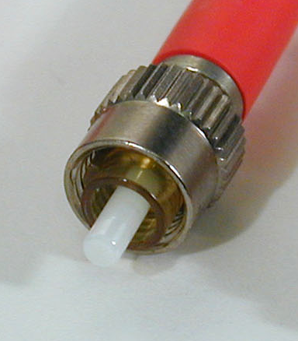
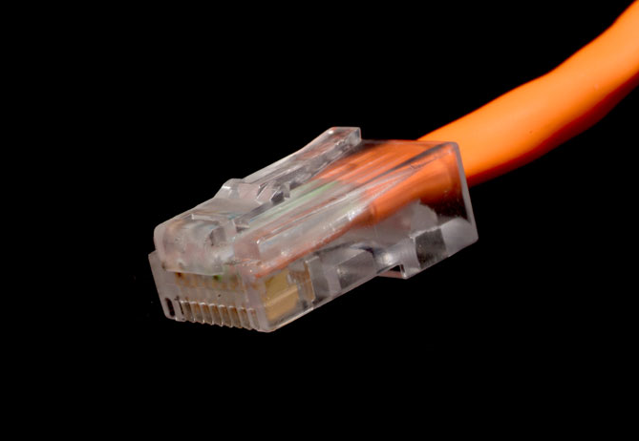
Physical Layer
Responsible for transmitting individual bits from one node to the next
Duties/services
Physical characteristics of interfaces and media
Representation of bits
Data rate (transmission rate)
Synchronization of bits

Slide 30
Physical Layer
from Data Link
to Data Link
Frame
Frame
01001011
01001011
(bits)
Transmission medium

Slide 31
The Big Picture
5
5
L5 data
H5
L5 data
H5
4
4
L4 data
H4
L4 data
H4
3
3
L3 data
H3
L3 data
H3
2
2
T2
L2 data
H2
T2
L2 data
H2
1
1
0111011010101001010101001
0111010101010010101010101
Transmission medium

Slide 32
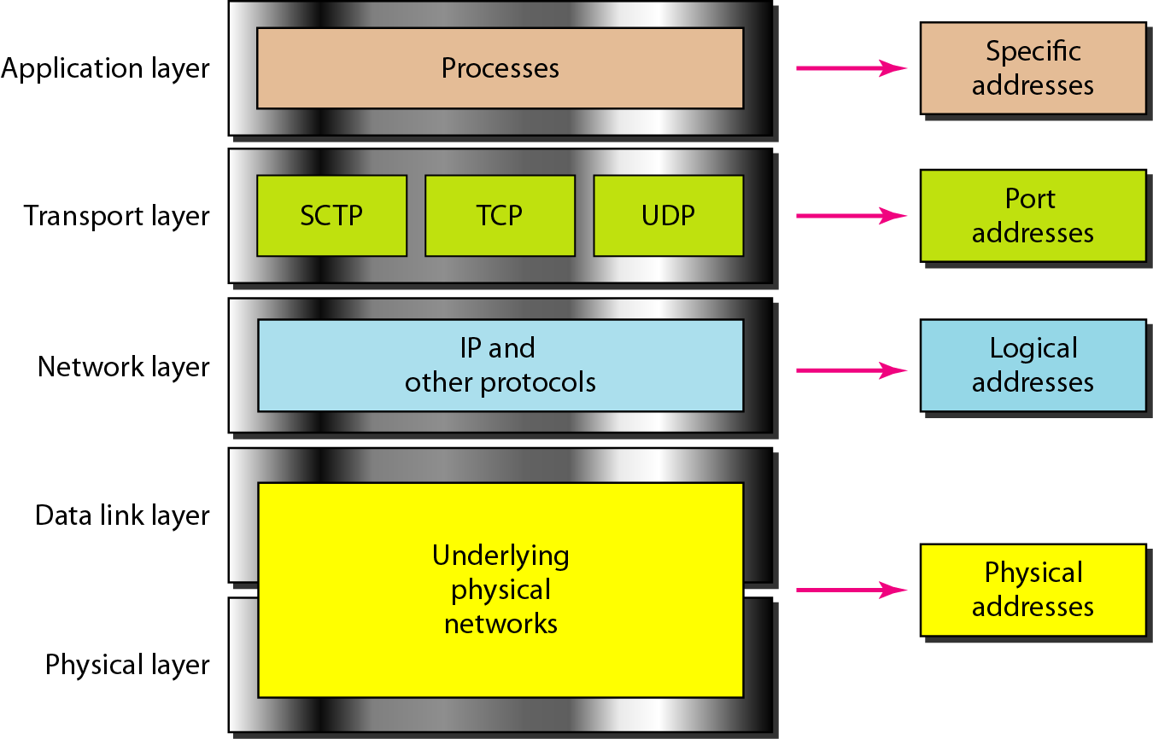
Layers and Addresses

Slide 33
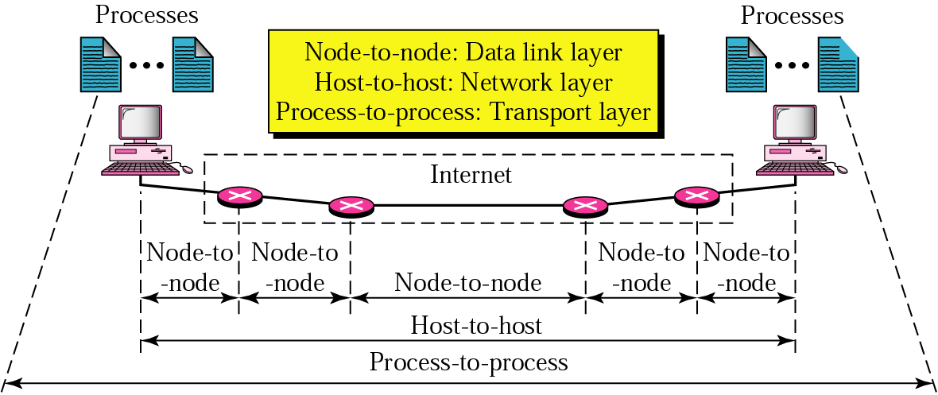
Layers and Types of Data Delivery

Slide 34
Internet Model
source
router
router
destination
Application
Transport
Network
Data Link
Physical
Application
Transport
Network
Data Link
Physical
Network
Network
D.L.
D.L.
D.L.
D.L.
P.L.
P.L.
P.L.
P.L.
Transmission medium

Slide 35
Protocol Suites
A set of protocols must be constructed
to ensure that the resulting communication system is complete and efficient
Each protocol should handle a part of communication not handled by other protocols
How can we guarantee that protocols work well together?
Instead of creating each protocol in isolation, protocols are designed in complete, cooperative sets called suites or families
Notes:
35

Slide 36
Internet Protocol Suite
Layer | Protocols
Application | HTTP, FTP, Telnet, SMTP, ...
Transport | TCP, UDP, SCTP, ...
Network | IP (IPv4), IPv6, ICMP, IGMP, ...
Data Link | Ethernet, Wi-Fi, PPP, ...
Physical | RS-232, DSL, 10Base-T, ...

Slide 37
OSI Model
User
OSI – Open Systems Interconnection
Developed by the International Standards Organizations (ISO)
Two additional layers
Presentation layer
Session layer
7.Application Layer
6.Presentation Layer
5.Session Layer
4.Transport Layer
3.Network Layer
2.Data Link Layer
1.Physical Layer
Transmission Medium

Slide 38














OSI Layers in Real World
7.Manager
Handwrites a message
Reads the message
Prepares final version
Summarizes or translates letter
6.Assistant
Provides address and packs letter
Opens letter
5.Secretary
Delivers letter to post office
Withdraws letter from mailbox
4.Driver
Checks address and sorts letter
Checks address and sorts letter
3.Postal staff
Packs letters for certain directions
Unpacks packages
2.Postal staff
Loads on truck
Unloads from truck
1.Postal staff
transmission medium
Pictures from Wikipedia

Slide 39
Session Layer
Responsible for establishing, managing and terminating connections between applications
Duties/services
Interaction management
⇨ Simplex, half-duplex, full-duplex
Session recovery

Slide 40
Presentation Layer
Responsible for handling differences in data representation to applications
Duties/services
Data translation
Encryption
Decryption
Compression

Slide 41
Summary
Layered tasks are used for abstracting complex communication details
Layer models were created for reference
Internet model (5 layers)
ISO's OSI model (7 layers)
Protocol suite is a collection of protocols operating at various layers

